Slide 1

[Samsung PRISM] Preliminary Discussion
24VI29- LIGHTWEIGHT TRANSFORMER-BASED HUMAN ACTION RECOGNITION ENGINE
Team
College Professor(s): Dr. Maheswari S / maheswari.s@vit.ac.in
: Dr. Anisha Natarajan / anisha.natarajan@vit.ac.in
Students:
Deepika R/ deepika.r2022@vitstudent.ac.in
Adrija Sarkar/ adrija.sarkar2022@vitstudent.ac.in
Aditya Kumar Jha/ adityakumar.jha2022@vitstudent.ac.in
Heet Jhaveri/ heet.bjhaveri2022@vitstudent.ac.in
Dhruvi Rank/ dhruvirank2005@gmail.com
Department: School of Computer Science and Engineering
School of Electronics Engineering
Date: 4th July, 2024

Slide 2



24VI29- LIGHTWEIGHT TRANSFORMER-BASED HUMAN ACTION RECOGNITION ENGINE
Problem Statement
Develop an efficient lightweight transformer based human action recognition engine
optimized for resource constrained environments, such as mobile devices or edge devices, capable of
accurately identifying and classifying various human activities in real time from video streams or
sequences, with minimal computational and memory requirements.
Input : Video/Frames Sequences.
Output : Actions Labels with Timestamp.
Expectations
A light-weight Engine to predict the Actions Labels along with timestamp.
Dataset generation with various input and outputs captured with good resolution, lighting condition and various depths
Demo Application
Potential Paper/Patent
Training/ Prerequisites
Good knowledge of Deep learning concepts.
Good hands on in Deep learning development frameworks like Tensorflow/Pytorch.
Model development, training and inference and deploying on resource constrained devices
Student Learning
Understand deep learning basics and the Transformer architecture for sequential data.
Learn techniques for creating efficient, lightweight models and compression methods.
Master data collection, preprocessing, and training transformer models.
Deploy models on resource-constrained devices and develop real-time applications.
Additional Documentation:
Lucene:
https://lucene.apache.org/
SQL To Lucene Sample :
https://github.com/bbejeck/sql-for-lucene
Srevatsa, Director
Vanraj, Manager
Kick Off 15 Sep 18
Understand Lucene
Implement Lucene Queries
Milestone 1 15 Oct 18
Basic Select Statements to Lucene Query working with projection and selection args.
Milestone 2 15 Nov 18
Insert , Update and Delete SQL Query to Lucene Query Working
Test Case Report
Closure 31st Dec 18
Project Report
Test Case Report
Demonstration
Notes:
-

Slide 3
Literature survey and study
Introduction :
Human action recognition (HAR) is a vital research area in computer vision and machine learning, encompassing applications from surveillance to healthcare. While deep learning models have significantly advanced HAR, their deployment on mobile and edge devices is challenged by limited computational resources and power constraints. Transformers, initially successful in natural language processing and later in image and video processing, show promise for HAR due to their ability to model complex patterns. However, traditional transformers are often too resource-intensive for mobile use. This literature survey reviews the latest advancements in lightweight transformer-based models for HAR, aiming to uncover new theories and identify novel approaches that enhance performance and efficiency on resource-constrained devices, thus paving the way for future research and development in this field.
Background :
Traditional methods of HAR such as Convolutional Neural Networks (CNNs) and Long Short-Term Memory networks (LSTMs) in which CNNs have been effective in extracting spatial features from images and videos, while LSTMs have been used to capture temporal dependencies in sequential data. However, these models have limitations, particularly when it comes to handling long-range dependencies and complex activity patterns. Transformers, known for their success in natural language processing, offer advanced capabilities for HAR by modeling long-range dependencies through self-attention mechanisms. However, their resource-intensive nature necessitates the development of lightweight transformer models for efficient deployment on mobile and edge devices.

Slide 4
Literature survey and study
Year | Name | Dataset | Signal Processing Technique | Architecture used | Accuracy | Suggestions for Novelty and improvement
2024 | Human action recognition with transformer based on convolutional features | UCF 50 UCF 101 (RGB Image Frames) | 1)Convolution 2)Layer Normalization | CNN+Transformers | 83.41% | Enhanced Transformer Architectures Integration of Multi-modal Data
2022 | Human Action Recognition with Transformers | HMDB-51 and UCF-101 | Framing | 1)3D-CNN Backbone Block 2)BERT-Based Temporal Pooling Block: | HMDB-51: Top-1 accuracy: 85.30% UCF-101: Top-1 accuracy: 98.51% | 1)Develop advanced temporal modeling techniques tailored for transformer architectures in human action recognition (HAR).

Slide 5
Literature survey and study
Year | Name | Dataset | Signal Processing Technique | Architecture used | Accuracy | Suggestions for Novelty and improvement
2024 | Lightweight human activity recognition method based on the MobileHARCmodel | SKODA HOSPITAL UCI-HAR OPPORTUNITY | 1)Convolution 2)Layer Normalization | 1)DeepConvLSTM 2)DeepConvLSTM_Attn 3)DDNN 4)Attend_Discriminate 5)Transformer_Encoder 6)ConvTransformer 7)Conformer 8)MobileHARC | For SKODA dataset 1)DeepConvLSTM- 87.98 2)DeepConvLSTM_Attn - 88.78 3)DDNN - 90.49 4)Attend_Discriminate - 89.49 5)Transformer_Encoder - 87.16 6)ConvTransformer - 90.68 7)Conformer - 90.70 8)MobileHARC - 91.32 | Based on the limitations identified, here are two ideas for future work: Optimization for Real-time Performance on Embedded Systems Robustness and Generalization Across Diverse Datasets
2023 | Skeletal Keypoint-Based Transformer Model for Human Action Recognition in Aerial Videos | Custom Aerial Video Dataset | Skeletal keypoint extraction using YOLOv8 | Transformer-based network with skeletal keypoints | Accuracy on test set: 85.3%, Precision: 84.1%, Recall: 83.7% | 1. Incorporate additional data augmentation techniques to improve generalization. 2. Experiment with different pose extractors to enhance keypoint accuracy. 3. Optimize the Transformer architecture by exploring various attention mechanisms.

Slide 6
Literature survey and study
Year | Name | Dataset | Signal Processing Technique | Architecture used | Accuracy | Suggestions for Novelty and improvement
2023 | STAR-Transformer: A Spatio-temporal Cross Attention Transformer for Human Action Recognition Dasom Ahn et al | Penn-Action | Cross-modal learning combining video frames and skeleton sequences | 1)Feature Extraction: Pre-trained ResNet mixed convolution 18 (MC18) 2)Tokens: Global Grid Token (GG-token) and Joint Map Token (JM-token) 3)Attention Mechanisms: Full Spatio-Temporal Attention (FAttn), Zigzag Spatio-Temporal Attention (ZAttn), Binary Spatio-Temporal Attention (BAttn) 4)Encoder-Decoder Structure: STAR-transformer encoder-decoder with multi-class token aggregation | 98.7% | 1.Enhance efficiency of token aggregation methods to further reduce computational complexity. 2.Explore alternative backbone architectures for feature extraction. 3.Investigate the impact of different joint heat map generation techniques on recognition accuracy. 4.Implement additional regularization techniques to improve model robustness. 5.Incorporate multi-scale attention mechanisms to capture finer details in action recognition. 6.Optimize the model for deployment on edge devices and real-time applications.

Slide 7
Literature survey and study
Year | Name | Dataset | Signal Processing Technique | Architecture used | Accuracy | Suggestions for Novelty and improvement
2023 | Human Activity Recognition Using IR-UWB Radar: A Lightweight Transformer Approach | 20 live individuals performing 20 distinct actions | One pulse transmitted, echo frame received sequentially. | Mobile ViT MobileNetv2 block | 1)MobileViTX(suggested) - 91.01% 2)MobileNetV2- 90.47% 3)Mobile ViT- 90.32% 4)RestNet - 90.26% | 1)Domain Adaptation 2)Self-Supervised Pre-Training 3)Stochastic Depth 4)Data Augmentation 5)Pruning and Quantization
2022 | LIGHTWEIGHT TRANSFORMERS FOR HUMAN ACTIVITY RECOGNITION ON MOBILE DEVICES | UCI MotionSense HHAR RealWorld SHL Preview | 1) Downsampling 2) Channel wise - Z- normalization | 1) CNN 2) CNN - LSTM 3) MobileViT 4) MobileHART | F - Score 1)CNN - 94.53 2)CNN-LSTM-92.8 3)MobileViT-96.55 4)MobileHART-97.6 | 1)Hyperparameter Tuning 2)Data Augmentation 3)Model Ensembling

Slide 8
Literature survey and study
Year | Name | Dataset | Signal Processing Technique | Architecture used | Accuracy | Suggestions for Novelty and improvement
2022 | A Hybrid Transformer Framework for Efficient Activity Recognition Using Consumer Electronics | HMDB51, UCF101, and UCF50 | 1)Segmentation of video stream 2)Temporal Processing | Hybrid Transformer Network for Human Activity Recognition | HMDB51 -76.1428% UCF101 - 96.6399% UCF50 - 97.3130% | 1)Integrate intelligent attention methods into the contextual model to effectively learn the most discriminative features. 2)Use optical flow to learn the motion dynamics of the video for higher performance.
2022 | Vision Transformer and Deep Sequence Learning for Human Activity Recognition in Surveillance Videos | UCF50 HMDB51 | Outlier and Noise detection and removal. | ViT for spatial features and multilayered LSTM to learn temporal relationships among these features to recognize human activities with higher confidence | UCF50 - 96.144 HMDB51 - 73.71 | Multi-view Data Integration Edge Computing Implementation

Slide 9
Literature survey and study
Discussion:
Across the reviewed papers, trends show a shift towards lightweight models using transformers. Common challenges include computational constraints and robustness to variations in data and environments. Future research should focus on enhancing model efficiency and adaptability, addressing current limitations.
Conclusion:
The literature review highlights the promise of lightweight transformers for HAR on mobile devices. Key insights reveal the need for efficient, robust models suitable for resource-constrained environments. Future research should aim to fill identified gaps and further improve model adaptability and efficiency.

Slide 10
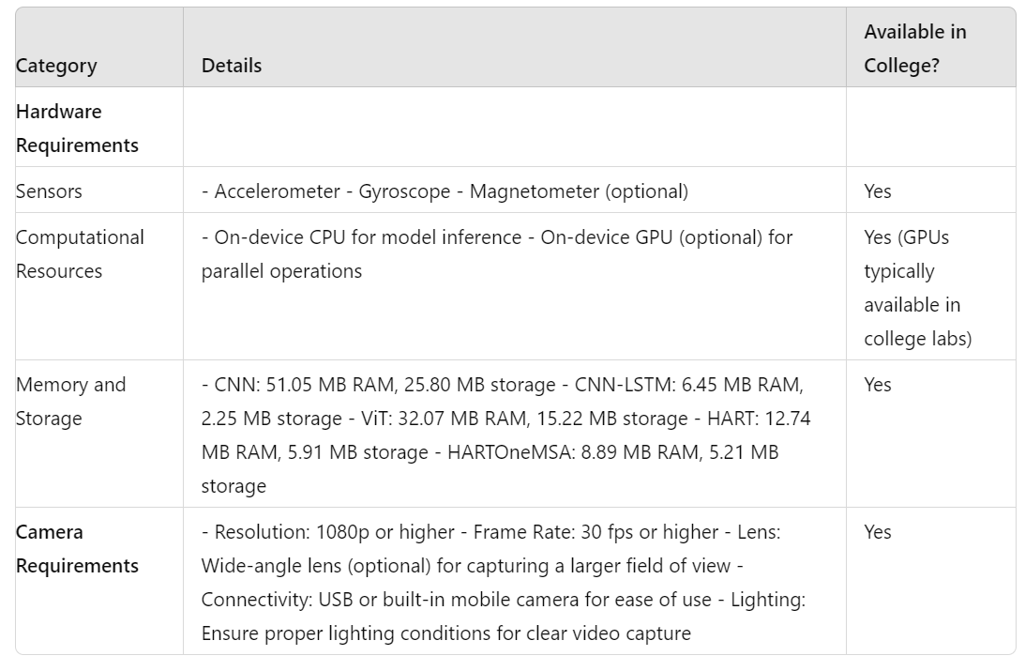
Identified Resource Requirements
Mention any GPU/Device etc requirement here clearly.
Also mention which of these can be fulfilled at college level (Lab etc).

Slide 11
Academic Calendar Breaks (If Any)
Mention any planned academic activity (Internals/Exams/Holidays/Events/Other Internships etc) in next 6 months which will impact project timeline.
This helps in setting up the expectation of delivery timeline.
The internal exams, final exam and the holidays are as follows:
24/08/2024-01/09/2024: Continuous Assessment Test I
12/10/2024-20/10/2024: Continuous Assessment Test II
26/10/2024-03/11/2024: Deepavali Holidays
18/11/2024-10/12/2024: Final Assessment Test

Slide 12
Queries
Challenges :
(Discuss in the form of bullets, what are the next action steps, any road blocks / bottlenecks)
Collecting high-quality data with good resolution, proper lighting conditions, and at various depths can be resource-intensive and time-consuming.
Ensuring the model can process data and make predictions in real-time on resource-constrained devices.
Deploying the model on resource-constrained devices, ensuring it runs efficiently with low latency.

Slide 13
Professor Comments
Tentative Monthly Progress Chart
Task | July 2024 | Aug 2024 | Sept 2024 | Oct 2024 | Nov 2024 | Dec 2024
Identification of objectives related to the given problem statement
Literature survey
Identification of hardware and software requirements
Sample collection and labelled dataset preparation for various human activities
Design of transformer model for activity classification
Preliminary testing and validation of proposed model
Model parameter tuning and performance enhancement. Model complexity analysis for deployment on constrained devices.
Report preparation and dissemination of results

Slide 14
Professor Comments
Latest paper reviewed regarding the problem statement area
A. Hussain et al., "A Hybrid Transformer Framework for Efficient Activity Recognition Using Consumer Electronics," in IEEE Transactions on Consumer Electronics, doi: 10.1109/TCE.2024.3373824.
Date of publication- March 2024
Employs a MobileNetv3 model to extract contextual features from video input.
This is particularly suitable for constrained devices.
Utilizes a sequential residual transformer for effectively learning long-term temporal dependencies in a video input.
Model validated on 3 benchmark datasets- HMDB51, UCF101 and UCF50.
Professor Expert Insights
Choice of a suitable model that guarantees high accuracy and low runtime complexity, will be challenge.

Slide 15
Thank you

